Slide 1



An Introduction to Large Language Models
Chapter 1

Slide 2


What Is Language AI?
[Artificial intelligence is] the science and engineering of making intelligent machines, especially intelligent computer programs. It is related to the similar task of using computers to understand human intelligence, but AI does not have to confine itself to methods that are biologically observable.
—J. McCarthy (2007). “What is artificial intelligence?”

Slide 3
A Recent History of Language AI
A peek into the history of Language AI.

Slide 4
Bag-of-words
A bag-of-words is created by counting individual words. These values are referred to as vector representations.
Notes:
Bag-of-words (1950-2000) works as follows: let’s assume that we have two sentences for which we want to create numerical representations. The first step of the bag-of-words model is tokenization, the process of splitting up the sentences into individual words or subwords (tokens)
Bag-of-words, although an elegant approach, has a flaw. It considers language to be nothing more than an almost literal bag of words and ignores the semantic nature, or
meaning, of text.
Released in 2013, word2vec was one of the first successful attempts at capturing the meaning of text in embeddings.3 Embeddings are vector representations of data that attempt to capture its meaning. To do so, word2vec learns semantic representations of words by training on vast amounts of textual data, like the entirety of Wikipedia.

Slide 5
Embeddings
The values of embeddings represent properties that are used to represent
words. We may oversimplify by imagining that dimensions represent concepts (which they don’t), but it helps express the idea.
Embeddings of words that are similar will be close to each other in dimensional
space.
Notes:
Embeddings can have many properties to represent the meaning of a word. Since the size of embeddings is fixed, their properties are chosen to create a mental representation of the word.
In practice, these properties are often quite obscure and seldom relate to a single entity or humanly identifiable concept. However, together, these properties make sense to a computer and serve as a good way to translate human language into computer language.
Embeddings are tremendously helpful as they allow us to measure the semantic similarity between two words.
In natural language processing, a word embedding is a representation of a word. The embedding is used in text analysis. Typically, the representation is a real-valued vector that encodes the meaning of the word in such a way that the words that are closer in the vector space are expected to be similar in meaning.[1] Word embeddings can be obtained using language modeling and feature learning techniques, where words or phrases from the vocabulary are mapped to vectors of real numbers.

Slide 6
Encoder and Decoder
The encoding step aims to represent the input as well as possible, generating the context in the form of an embedding, which serves as the input for the decoder. To generate this representation, it takes embeddings as its inputs for words, which means we can use word2vec for the initial representations.

Slide 7
Attention Is All You Need
The architecture of a BERT base model with 12 encoders.
Notes:
Attention allows a model to focus on parts of the input sequence that are relevant to one another (“attend” to each other) and amplify their signal, as shown in Figure
1-14. Attention selectively determines which words are most important in a given sentence.
BERT model is based on attention architecture (Transformers). BERT is an encoder-only architecture that focuses on representing language, as illustrated in Figure 1-21. This means that it only uses the encoder and removes the decoder entirely.
The original Transformer model is an encoder-decoder architecture that serves translation tasks well but cannot easily be used for other tasks, like text classification.

Slide 8
BERT. Mask technique
Train a BERT model by using masked language modeling.
Notes:
Mask: this method masks a part of the input for the model to predict. This prediction task is difficult but allows BERT to create more accurate (intermediate) representations of the input.
This architecture and training procedure makes BERT and related architectures incredible at representing contextual language.
BERT-like models are commonly used for transfer learning, which involves first pretraining it for language modeling and then fine-tuning it for a specific task. For instance, by training BERT on the entirety of Wikipedia, it learns to understand the semantic and contextual nature of text. Then, as shown in Figure 1-23, we can use that pretrained model to fine-tune it for a specific task, like text classification.

Slide 9
BERT. Mask technique
After pretraining BERT on masked language model, we finetune it for specific tasks.
Notes:
Fine-tuning on specific tasks is generally less compute-intensive and requires less data.
Encoder-only models, like BERT, for years, they have been and are still used for common tasks, including classification tasks, clustering tasks, and semantic search.
We will refer to encoder-only models as representation models to differentiate them from decoder-only, which we refer to as generative models.

Slide 10
GPT´s models
Notes:
The architecture of a GPT-1. It uses a decoder-only architecture and removes the encoder-attention block.
Similar to the encoder-only architecture of BERT, a decoder-only architecture was proposed in 2018 to target generative tasks.7 This architecture was called a Generative
Pre-trained Transformer (GPT) for its generative capabilities (it’s now known as GPT-1 to distinguish it from later versions). It stacks
decoder blocks similar to the encoder-stacked architecture of BERT.

Slide 11
GPT´s models
GPT models quickly grew in size with each iteration.
Notes:
GPT-1 was trained on a corpus of 7,000 books and Common Crawl, a large dataset of web pages. The resulting model consisted of 117 million parameters. Each parameter
is a numerical value that represents the model’s understanding of language.

Slide 12
Generative models
A comprehensive view into the Year of Generative AI. Note that many
models are still missing from this overview!.

Slide 13
Traditional vs LLM training
Compared to traditional machine learning, LLM training takes a multistep
approach..

Slide 14
Responsible LLM Development and Usage
Bias and fairness
Generating harmful content
Intellectual property
Regulation

Slide 15








INTRODUCTION
AI, or Artificial Intelligence, refers to the simulation of human intelligence in machines that are programmed to think and act like humans. AI is designed to solve complex problems and improve efficiency and accuracy in decision-making.
01

Slide 16









TYPES OF AI
NARROW AI
GENERAL AI
SUPER AI
Narrow AI is designed to perform a specific task
General AI can perform any intellectual task that a human can
Super AI is hypothetical and would surpass human intelligence

Slide 17





HISTORY OF AI
The Dartmouth Conference, where the term "artificial intelligence" was first coined and AI was established as a field of research.
1956
The first AI system that could understand and respond to natural language was created by Terry Winograd, which marked a major step forward in natural language processing.
1974
IBM's Deep Blue defeated the world chess champion Garry Kasparov, demonstrating that machines could surpass human intelligence in specific domains.
1997
The emergence of deep learning led to breakthroughs in computer vision, speech recognition, and natural language processing.
2012

Slide 18


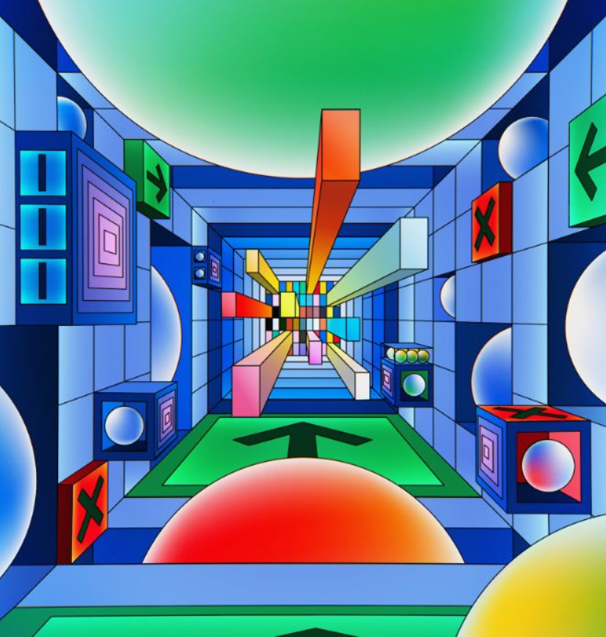
AI APPLICATIONS IN INDUSTRIES
AI has the potential to revolutionize numerous industries by providing new and innovative solutions to complex problems. From healthcare to finance, AI is already being used to improve efficiency, increase accuracy, and drive innovation. This section will explore some of the practical applications of AI in various industries, demonstrating the real-world impact of this technology.
02

Slide 19








IN HEALTHCARE
IDENTIFY CANCEROUS GROWTHS
01
In a study of 33,000 patient chest x-rays, an AI algorithm was able to identify potentially cancerous growths with 94% accuracy.
HEALTHCARE TOOLS
02
By 2026, the global market for AI-powered healthcare tools is projected to reach $28 billion.
MANAGEMENT
03
AI-powered virtual assistants can help doctors and nurses manage their schedules, order tests, and prioritize patient care.

Slide 20



IN FINANCE
75%
12,000
50%
people said that AI has improved their decision-making process.
Morgan Chase used AI to analyze 12,000 commercial loan agreements in seconds
The use of AI in fraud detection has led to a 50% reduction in false positives

Slide 21








IN MANUFACTURING
Item 2
Item 3
12
10
8
6
4
2
0
2015
2016
2017
2018
2019
2020
2021

Slide 22




IN TRANSPORTATION
REDUCE 20% FUEL CONSUMPTION
REDUCE 30% MAINTENANCE COSTS
Self-driving trucks powered by AI have been shown to reduce fuel consumption by up to 20%, saving companies thousands of dollars per year.
AI-powered predictive maintenance can reduce maintenance costs by up to 30%, and increase vehicle reliability and uptime.

Slide 23


03
SOCIAL IMPLICATIONS
Explores the broader impact of AI beyond specific industries or applications. Considers ethical and societal implications such as job displacement, bias, privacy concerns, and potential impacts on democracy and human rights. Encourages a critical and thoughtful approach to AI development and deployment, taking into account the potential risks and benefits to individuals and society as a whole.

Slide 24




AI AND JOBS
JOBS AT HIGH RISK
JOBS AT SIGNIFICANT RISK
14%
32%

Slide 25



AI ETHICS
81%
People believe that companies should prioritize ethical considerations
63%
Were concerned about the ethical implications of the AI system

Slide 26
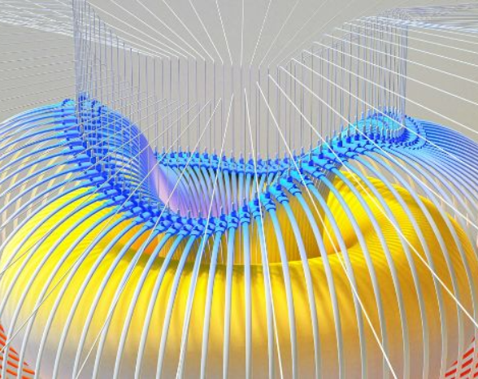

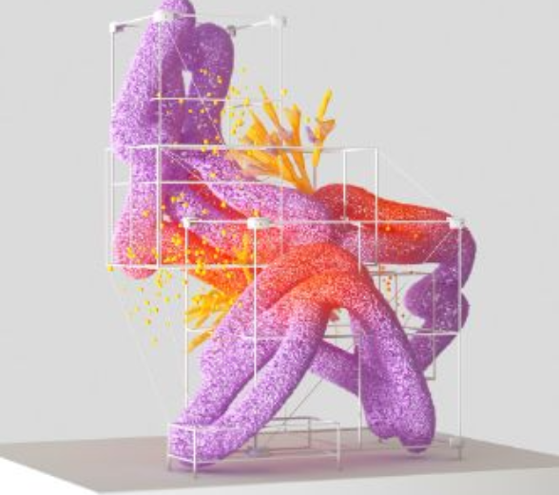

AI AND PRIVACY
A survey by Pew Research Center found that 64% of Americans are concerned about the way that companies are using their data, and 81% feel that they have little or no control over the data that companies collect about them.
20%
55%
The EU's GDPR includes provisions for ensuring that individuals have the right to access and control their personal data, including data that is processed using AI systems.

Slide 27

AI AND SOCIETY
Discusses the broader societal implications of AI, including its impact on job displacement, inequality, and social norms. This section aims to provide a comprehensive understanding of the ways in which AI is shaping our society and the challenges that need to be addressed.
04

Slide 28


THE RISE OF POWERFUL AI WILL BE EITHER THE BEST OR THE WORST THING EVER TO HAPPEN TO HUMANITY. WE DO NOT YET KNOW WHICH.
STEPHEN HAWKING

Slide 29








THANK YOU FOR
CHOOSING EATEMP
We offer free and high-quality slides templates for your presentations. We appreciate you choosing us and hope our templates have been helpful.
As a new website, we rely on your support to grow, so please help us by sharing our site with your friends and colleagues.
eatemp._
@eatemp
eatempofficial
@eatemp.official

